Slide 1
Class XII Project Presentation
Quiz
By : Asrith Vatsal (19)
Roushan kumar (30)
Abhishek kumar raj (64)

Slide 2


Technologies Used
&

Slide 3
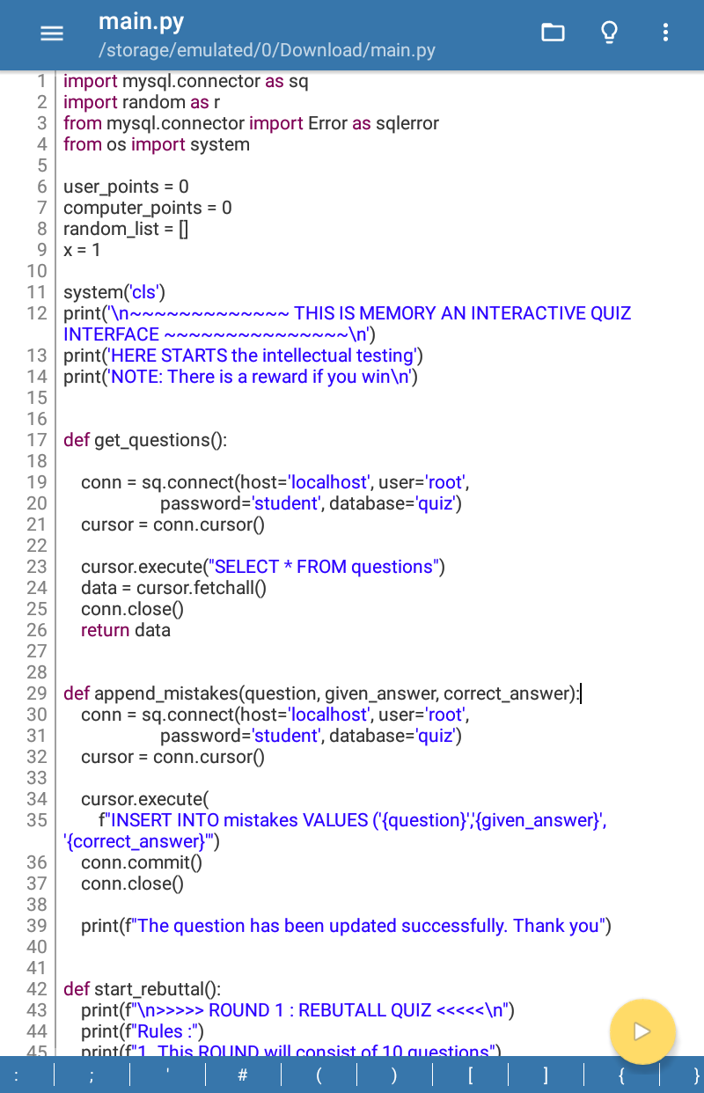
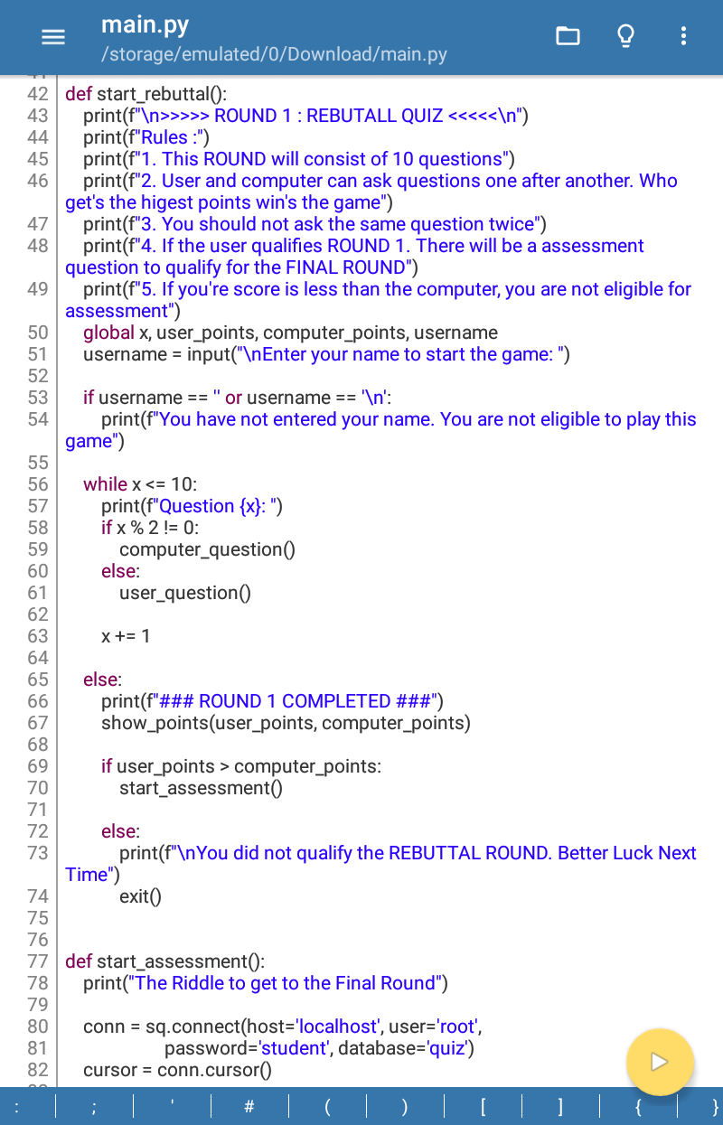
CODE OF PROGRAM

Slide 4
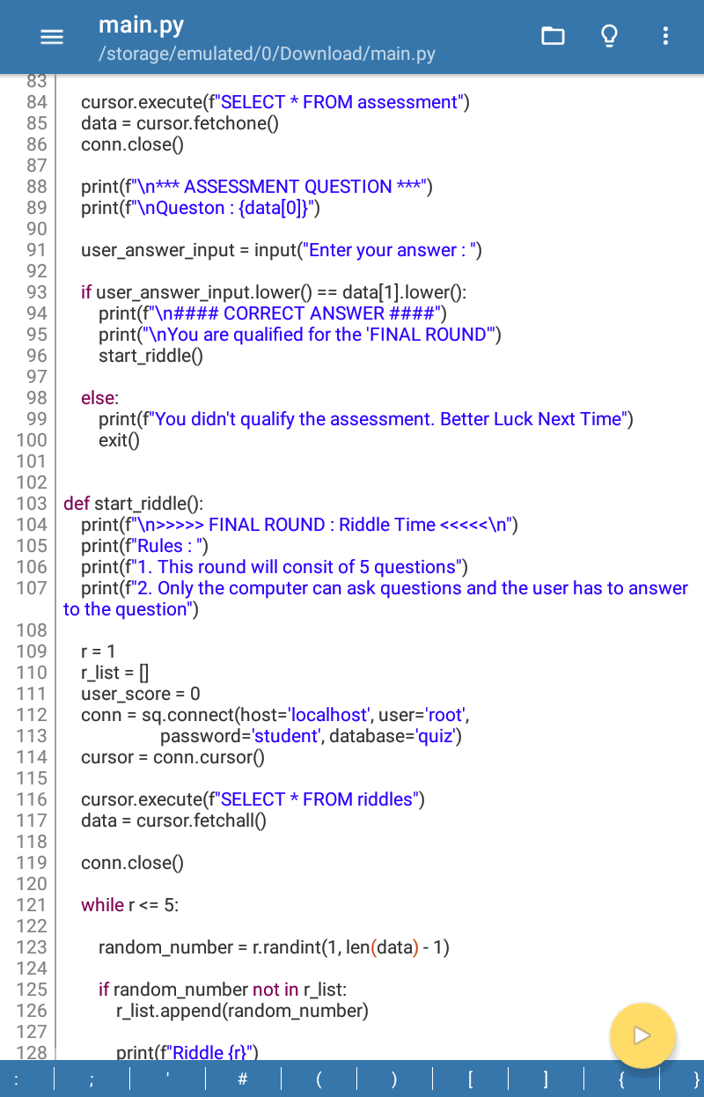
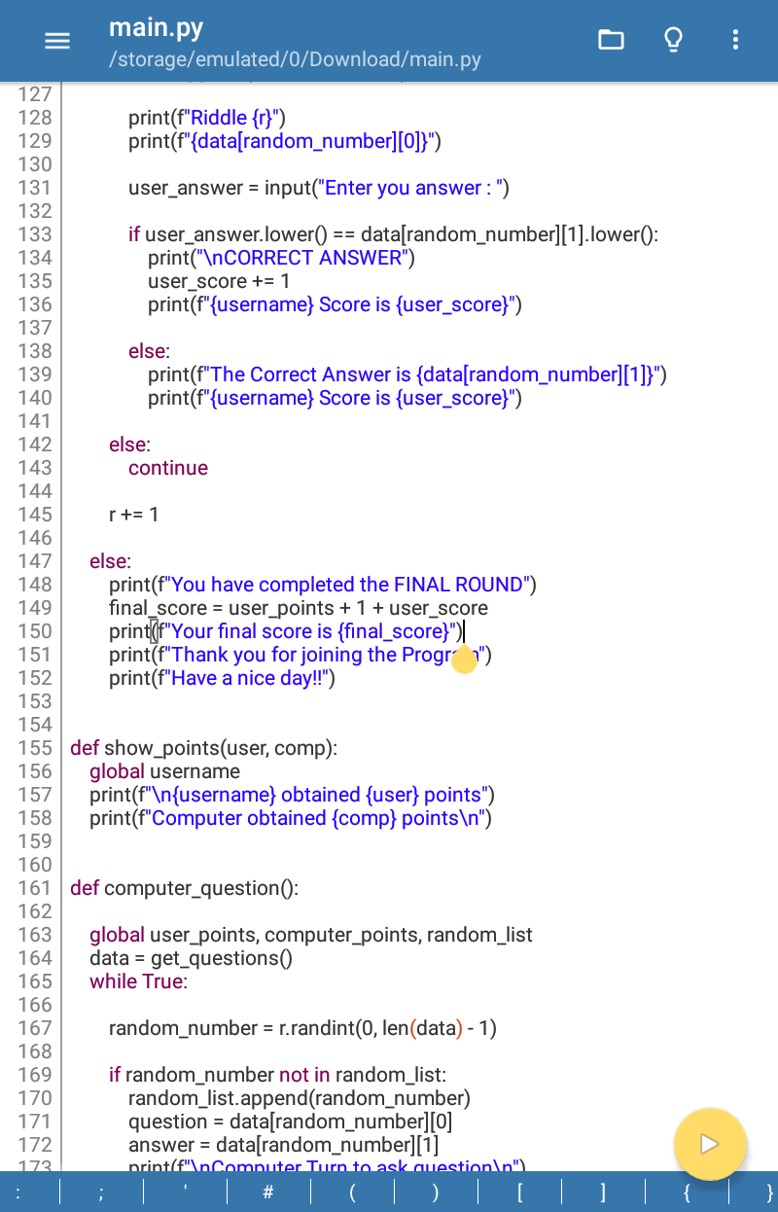
CODE OF PROGRAM

Slide 5
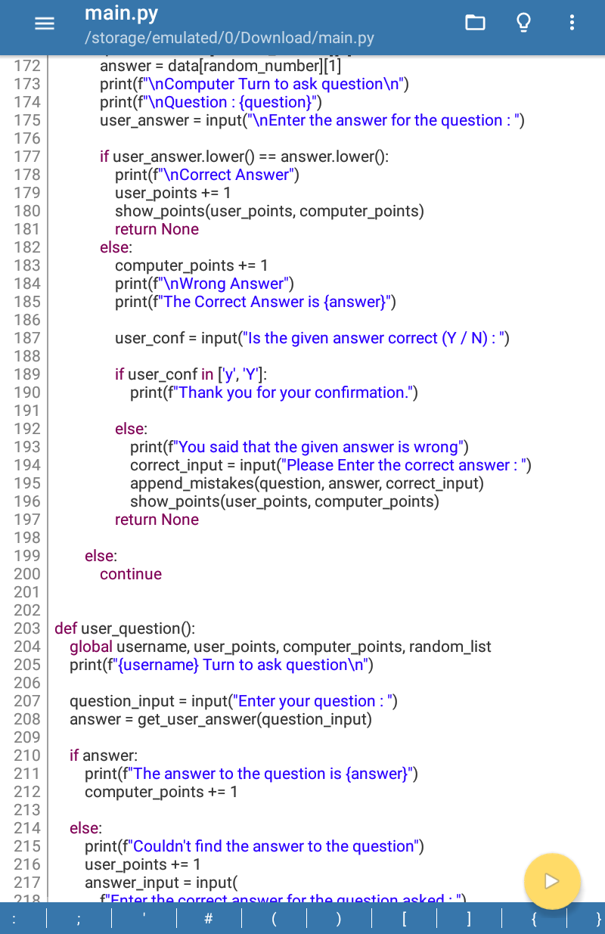
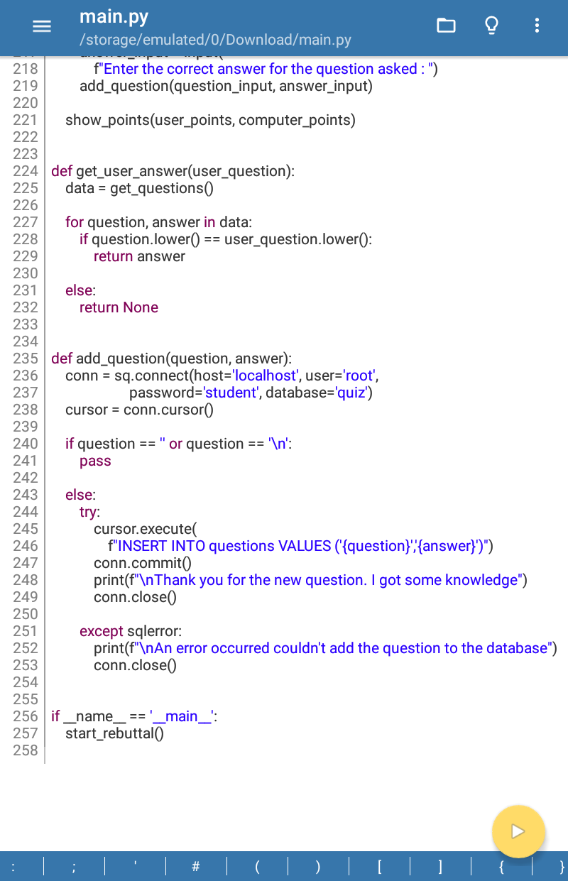
CODE OF PROGRAM

Slide 6
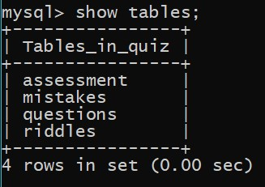
Tables used in the program

Slide 7
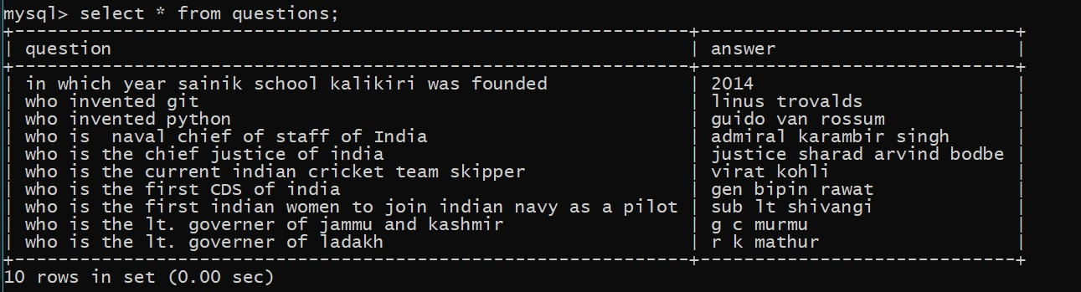
Table for the first round of the quiz
The first round of quiz is a rebuttal round where both user and computer ask questions to each other alternatively.
The questions will be automatically updated after the program is terminated.
The questions which the computer doesn't know will be asked to the user to feed in the question with it's answer

Slide 8
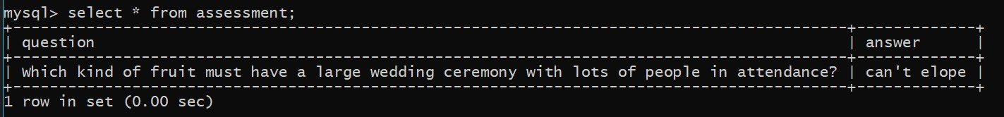
Assessment Table
Table containing a question for jumping from round one to round two
If the user answer's it wrong then the total marks will be displayed only for round one and that will be the final result.

Slide 9
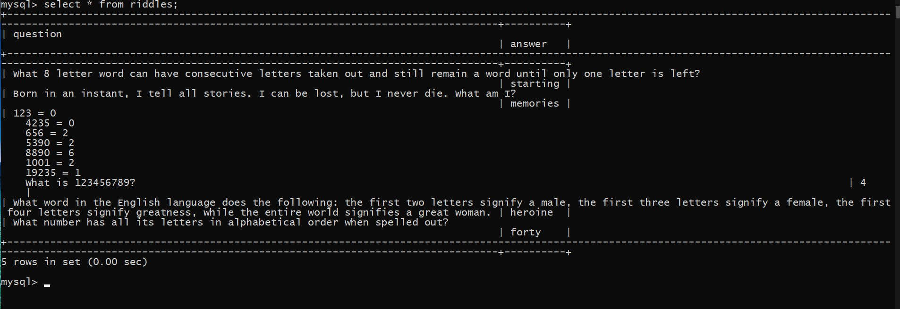
Table for round two
Table of Riddles with their answers

Slide 10
Last feature of the program
The last feature of the program is to rectify the wrong answers of the first round. Which will be stored in a new table called mistakes.
The programer must change those anwers after the program is terminated with the help of mysql.

Slide 11
Available Features for Cadet
To ask questions in the first round to the computer.
To rectify the wrong questions by typing them when it's asked in the program.

Slide 12
Thank You

